Slide 1

Employee Management System
Presented by :
Galapalwar Shivani
Batch No : 536

Slide 2
About me
Background :
I completed my Bachelor of Technology in CSE from Bharat institute of engineering and technology
Why you want to learn Data Science :
I want to learn Data Science to turn data into meaningful insights and build practical solutions using data.
Any work experience :
Fresher
LinkedIn : https://www.linkedin.com/in/galapalwar-shivani-04782640b/
GitHub : https://github.com/shivanigalpalwar

Slide 3
Agenda:
Business Problem
Problem Statement
Introduction
Data Description
Queries and Results
Key Insights
Recommendations
Conclusion

Slide 4
Business Problem :
Organizations manage a large amount of employee information, including employee details, job roles, departments, salaries, qualifications, leaves, and payroll. Managing and analyzing this information manually can be time-consuming and may make it difficult to identify important workforce trends. HR teams need a structured system to understand employee distribution, salary allocation, job roles, leave patterns, bonuses, and payroll. Therefore, there is a need for an efficient database system that organizes employee information and supports meaningful analysis for better HR and compensation-related decision-making.

Slide 5
Problem Statement :
The Employee Management System is designed using SQL to store and analyze employee-related information in a structured manner. The project covers employee details, departments, job roles, salary ranges, qualifications, leaves, and payroll records. SQL queries are used to generate insights such as employee counts, average salary ranges, highest-paid roles, qualification patterns, leave trends, monthly payroll, and bonuses. The project also applies advanced SQL concepts such as joins, subqueries, CTEs, derived tables, EXISTS, window functions, and stored procedures to perform effective data analysis.

Slide 6
Introduction
This project is based on an Employee Management System that contains data related to employees, departments, job roles, salaries, qualifications, leaves, and payroll. The data is organized across multiple related tables to maintain employee information in a structured way. The project uses SQL to manage, analyze, and extract useful information from this data. It focuses on understanding employee distribution across departments and different job roles. It also analyzes salary ranges, payroll, bonuses, employee qualifications, and leave patterns. The project helps identify areas such as departments with more employees, higher salary allocations, and employees with more qualifications or leaves. Overall, the project demonstrates how SQL can be used to convert employee data into meaningful insights for better management and decision-making.

Slide 7
Data Description :
Table Name | Column Name | Data Type
JobDepartment | Job_ID | INT
JobDepartment | jobdept | VARCHAR(50)
JobDepartment | name | VARCHAR(100)
JobDepartment | description | TEXT
JobDepartment | salaryrange | VARCHAR(50)
SalaryBonus | salary_ID | INT
SalaryBonus | Job_ID | INT
SalaryBonus | amount | DECIMAL(10,2)
SalaryBonus | annual | DECIMAL(10,2)
SalaryBonus | bonus | DECIMAL(10,2)
Employee | emp_ID | INT
Employee | firstname | VARCHAR(50)
Employee | lastname | VARCHAR(50)
Employee | gender | VARCHAR(50)

Slide 8
Table Name | Column Name | Data Type
Employee | age | INT
Employee | contact_add | VARCHAR(100)
Employee | emp_email | VARCHAR(100)
Employee | emp_pass | VARCHAR(100)
Employee | Job_ID | INT
Qualification | QualID | INT
Qualification | Emp_ID | INT
Qualification | Position | VARCHAR(50)
Qualification | Requirements | VARCHAR(255)
Qualification | Date_In | DATE

Slide 9
Table Name | Column Name | Data Type
Leaves | leave_ID | INT
Leaves | emp_ID | INT
Leaves | date | DATE
Leaves | reason | TEXT
Payroll | payroll_ID | INT
Payroll | emp_ID | INT
Payroll | job_ID | INT
Payroll | salary_ID | INT
Payroll | leave_ID | INT
Payroll | date | DATE
Payroll | report | TEXT
Payroll | total_amount | DECIMAL(10,2)

Slide 10
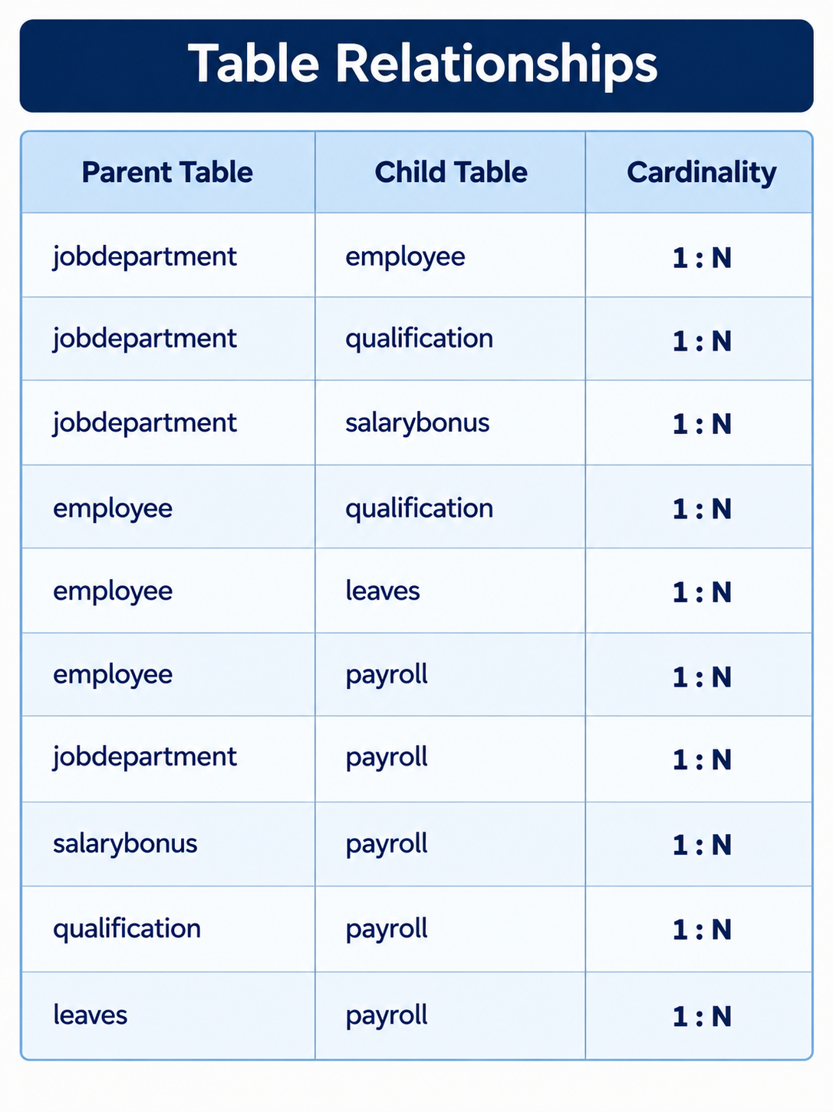
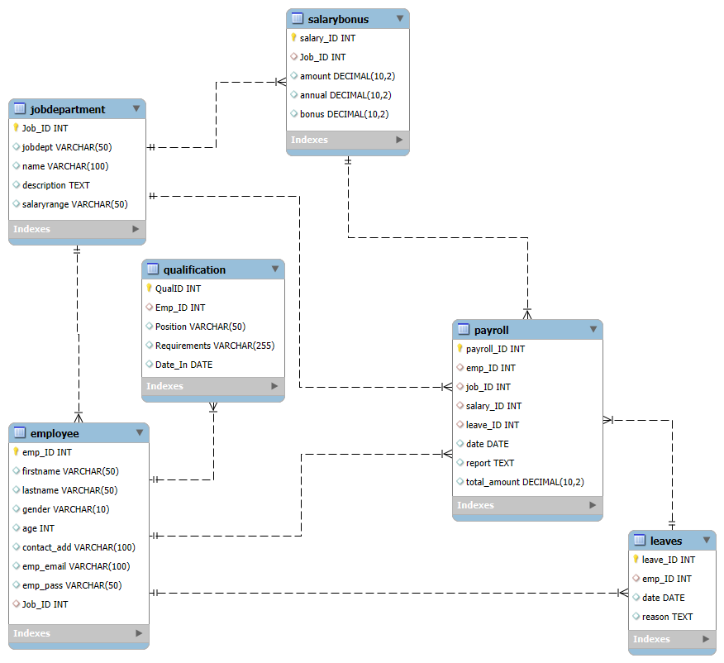
ER DIAGRAM

Slide 11
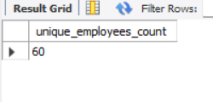
Queries and Results :
1. How many unique employees are currently in the system?
SELECT COUNT(*) AS unique_employees_count
FROM (
SELECT DISTINCT emp_ID
FROM Employee
) AS unique_emp;

Slide 12
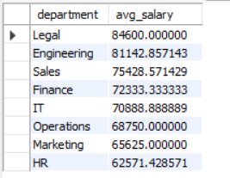
2. What is the average salary per department?
SELECT
jd.jobdept AS department, AVG(s.amount) AS avg_salary
FROM
salarybonus AS s
JOIN
jobdepartment AS jd ON jd.Job_ID = s.Job_ID
GROUP BY jd.jobdept
ORDER BY avg_salary DESC;

Slide 13
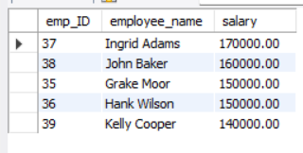
3. Who are the top 5 highest-paid employees?
WITH ranked_employees AS (
SELECT
e.emp_ID,
CONCAT(e.firstname, ' ', e.lastname) AS employee_name,
s.amount AS salary,
ROW_NUMBER() OVER (ORDER BY s.amount DESC) AS salary_rank
FROM Employee e
JOIN SalaryBonus s
ON e.Job_ID = s.Job_ID
)
SELECT emp_ID,
employee_name,
salary
FROM ranked_employees
WHERE salary_rank <= 5
ORDER BY salary_rank;

Slide 14
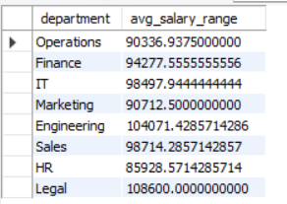
4. What is the average salary range per department?
SELECT
jd.jobdept AS department,
AVG((CAST(REPLACE(TRIM(SUBSTRING_INDEX(jd.salaryrange, '-', 1)),
'$’,
‘’)
AS DECIMAL (10 , 2 )) + CAST(REPLACE(TRIM(SUBSTRING_INDEX(jd.salaryrange, '-', - 1)),
'$’,
‘’)
AS DECIMAL (10 , 2 ))) / 2) AS avg_salary_range
FROM
jobdepartment AS jd
GROUP BY jd.jobdept;

Slide 15
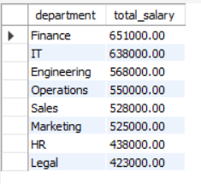
5. Which departments have the highest total salary allocation?
SELECT
jd.jobdept AS department, SUM(s.amount) AS total_salary
FROM
jobdepartment jd
JOIN
salarybonus s ON jd.Job_ID = s.Job_ID
GROUP BY jd.jobdept
ORDER BY total_salary DESC;

Slide 16

6. How many employees have at least one qualification listed?
SELECT COUNT(*) AS emp_with_qualifications
FROM Employee e
WHERE EXISTS (
SELECT 1
FROM Qualification q
WHERE q.Emp_ID = e.emp_ID
);

Slide 17
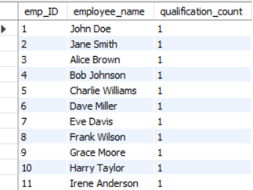
7. Which employees have the highest number of qualifications?
WITH employee_qualifications AS (
SELECT
e.emp_ID,
CONCAT(e.firstname, ' ', e.lastname) AS employee_name,
COUNT(q.QualID) AS qualification_count
FROM Employee e
JOIN Qualification q
ON e.emp_ID = q.Emp_ID
GROUP BY e.emp_ID, e.firstname, e.lastname
)
SELECT emp_ID,
employee_name,
qualification_count
FROM employee_qualifications
WHERE qualification_count = (
SELECT MAX(qualification_count)
FROM employee_qualifications
);

Slide 18

8. What is the total monthly payroll processed?
DELIMITER $$
CREATE PROCEDURE GetMonthlyPayroll(IN payroll_month INT)
BEGIN
SELECT
MONTHNAME(date) AS month,
SUM(total_amount) AS total_monthly_payroll
FROM Payroll
WHERE MONTH(date) = payroll_month
GROUP BY MONTH(date), MONTHNAME(date);
END $$
DELIMITER ;
CALL GetMonthlyPayroll(3);

Slide 19
Key Insights:
The analysis identifies the total number of unique employees currently recorded in the system.
Salary analysis helps compare the average compensation levels across different departments.
The query highlights the five employees receiving the highest salaries in the organization.
The analysis determines the overall salary expenditure of the company.
The salary ranges help compare the typical compensation levels offered across departments.
The analysis identifies the departments receiving the largest share of the company’s salary allocation.
The query identifies how many employees have at least one qualification recorded in the system.
The analysis highlights employees who have the greatest number of qualifications listed.
Leave data helps compare the average number of leave days taken by employees across departments.
The analysis identifies employees who have taken the highest number of leaves.
The payroll analysis shows the total amount processed by the company on a monthly basis.

Slide 20
Recommendations
Regularly monitor salary and payroll expenses for better budget management.
Review departments with higher leave rates to improve workforce planning.
Encourage employees to participate in skill-development and training programs.
Periodically review salary ranges and bonuses to maintain fair compensation.
Use employee qualification data to identify training and development needs.
Analyze payroll trends to support better financial planning and resource allocation.
Use employee and department insights to support data-driven HR decisions.

Slide 21
Conclusion
The Employee Management System successfully demonstrates how SQL can be used to organize and analyze employee-related data in a structured way. The project provides insights into employees, departments, job roles, salaries, qualifications, leaves, and payroll. Through different SQL queries and techniques, important patterns related to compensation, workforce distribution, qualifications, and employee attendance can be identified. Overall, the project shows how effective data analysis can support better HR management, informed decision-making, and efficient workforce planning.

Slide 22
Q&A

Slide 23

THANK YOU

